Slide 1
RESPECT TO ELDERS
AN ASPECT OF AFRICAN CULTURE

Slide 2
Wisdom in tradition
In African culture, respect for elders is a fundamental value shared across various ethnic groups and nations. This respect is demonstrated through honoring their wisdom, seeking their advice, and following their guidance in both family and community matters.
It remains a vital practice that influences societal norms and relationships today.
This presentation examines the importance of respecting elders in African culture, its historical significance, its evolution in modern times, and the role of gender awareness in this tradition.

Slide 3
Why the respect?
In many African cultures, elders are esteemed as the custodians of wisdom, tradition, and history. They embody the community's collective memory, preserving essential knowledge about historical events, moral values, and survival skills crucial for societal well-being.
Respect for elders is demonstrated through specific cultural practices such as greeting with bowing or kneeling, and using honorific titles. These gestures and forms of speech reinforce social hierarchy and acknowledge the elder’s role as a guide and mentor.
Elders are pivotal in conflict resolution and decision-making within their communities. Their advice and judgments are highly valued for mediating disputes and making decisions, reflecting a deep understanding of community history and values.

Slide 4
Advantages
Preservation of Cultural Heritage
Elders act as the custodians of cultural heritage, preserving and passing down the community's traditions, customs, and values through oral storytelling and rituals.
Through oral storytelling, rituals, and teachings, elders pass down the collective wisdom of the community to younger generations
This transmission of knowledge ensures cultural practices and identity are maintained across generations, fostering a strong sense of belonging and continuity.

Slide 5
Mediators of Harmony
Social Stability and Conflict Resolution
By serving as mediators in conflicts and disputes, elders contribute to social stability. Their wisdom and experience enable them to offer fair and balanced judgments. This helps to prevent conflicts from escalating and promoting harmony within the community.
Strengthening Family and Community Bonds
Respect for elders enhances family and community bonds, fostering a culture of care and responsibility. This mutual respect and support strengthen the social fabric of African societies, where younger people are encouraged to support and care for their elders, reinforcing interdependence and community cohesion

Slide 6
Guides and Mentors
Guidance and Mentorship
Elders provide invaluable guidance and mentorship to younger generations, helping them navigate life's complexities. Their life experiences offer lessons in marriage, parenting, leadership, and morality, aiding young people in making informed decisions and supporting their personal development.

Slide 7
Disadvantages
Resistance to Change and Innovation Respect for elders can sometimes hinder progress by prioritizing tradition over modernity. Elders’ conservative views may resist new ideas and technologies, which can constrain younger generations and impede societal advancement.
Potential for Abuse of Power The high regard for elders can lead to an abuse of authority. When elders are seen as infallible, they might impose decisions without considering other perspectives, potentially leading to unfair outcomes or favoritism.

Slide 8
Respect Hurdles…
Gender Inequality In patriarchal societies, respect for elders may reinforce gender disparities. Elder men often hold more power than elder women, potentially marginalizing women’s voices and contributions and perpetuating gender inequality.
Generational Tensions The deference to elders can create generational conflicts, especially when older and younger generations have differing values and beliefs. This can result in frustration, alienation, and a lack of opportunities for younger individuals to express their views.

Slide 9
Past and Present
Historical Role of Respecting Elders
In pre-colonial African societies, elders were pivotal in governance and social organization. They held authority through their deep knowledge of community history, customs, and spiritual beliefs, serving as primary decision-makers and conflict resolvers.
Elders also played a key role in education, transmitting knowledge and skills through storytelling, proverbs, and practical instruction. Their role was intertwined with religious beliefs, often seen as intermediaries between the living and ancestors, which reinforced their social status and reverence.

Slide 10
Present more clearly…
Contemporary Role of Respecting Elders
Today, the tradition of respecting elders persists but faces new challenges due to modernization, urbanization, and globalization. In rural and traditional communities, elders continue to influence decision-making and conflict resolution.
However, urban settings and younger generations increasingly challenge their authority due to rapid changes and global cultural influences.
The role of elders in education has shifted with the rise of formal education systems and digital media, many knowledge sources. Despite these changes, respect for elders remains a cornerstone of African culture, offering continuity and stability amidst a changing world. Elders are still valued for their wisdom and guidance in family, community, and traditional matters.

Slide 11
GENDER AWARENESS
Gendered Dynamics of Respect
In traditional African societies, respect for elders often reflects broader patriarchal structures, with elder men typically holding more authority than elder women. This gendered distribution of power results in elder men being recognized as primary authority figures, while elder women often occupy more informal or supportive roles.
Despite their crucial contributions as caregivers and educators, elder women’s roles may be undervalued compared to the public roles of elder men. This disparity perpetuates gender inequalities, limiting women's opportunities for leadership and influence within the community.

Slide 12
What has changed…
Evolving Gender Roles and Respect
As African societies progress, there is a growing recognition of gender equality and the need to value contributions from both men and women.
Efforts are being made to include elder women in traditional councils and decision-making bodies, promoting gender balance and acknowledging their roles in leadership.
This shift also influences younger generations, who are increasingly challenging traditional gender norms and advocating for more equitable relationships between men and women.These changes reflect broader societal shifts and global movements for gender equality, fostering a more inclusive approach to respecting elders.

Slide 13
What the Future holds…
Embracing Change While Honoring Tradition
The tradition of respecting elders in African culture will evolve as societies adapt to modernization and globalization. Balancing the preservation of cultural values with the need for progress will be crucial.
Communities may need to reassess traditional hierarchies and structures to ensure they stay relevant and responsive to contemporary needs, while continuing to honor the wisdom and contributions of elders.

Slide 14
Redefining Respect
Promoting Gender Equality
With increasing awareness of gender issues, there is an opportunity to redefine respect for elders in a way that promotes gender equality.
Creating inclusive spaces for elder women and recognizing their contributions equally to those of elder men can help address gender disparities.
This shift will enable African societies to build on their cultural strengths while fostering greater equity and justice.

Slide 15
Digital Respect
Leveraging Technology and Education
Technology and education will play significant roles in shaping the future of respecting elders.
As digital tools expand access to information, younger generations gain new learning methods, which could challenge the traditional authority of elders.
However, technology also offers opportunities for elders to share their wisdom more widely and engage with younger people. Integrating respect for elders into education systems can ensure that this tradition remains valued in modern society.

Slide 16
Conclusion
Respect for elders is a foundational aspect of African culture, reflecting wisdom, tradition, and community values.
While it offers benefits such as cultural preservation and social stability, challenges like gender inequality and resistance to change must be addressed.
By embracing change, promoting gender equality, and utilizing technology and education, African societies can maintain a vibrant and meaningful tradition of respecting elders in the future.

Slide 17
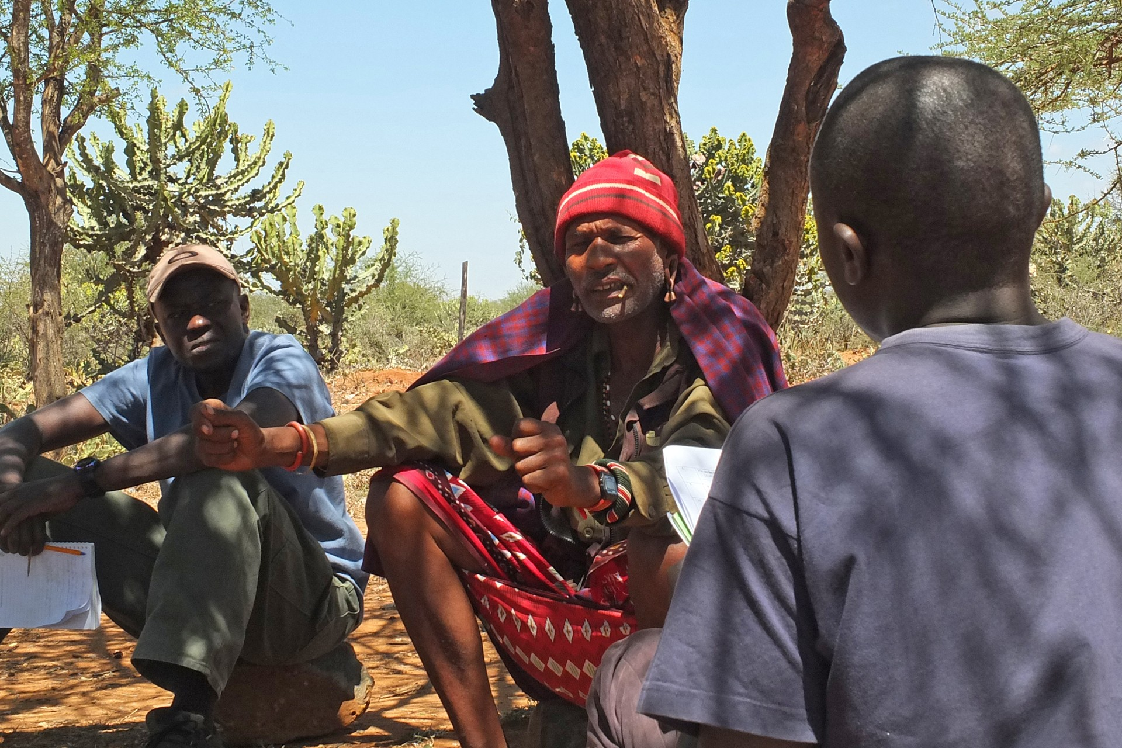
THANK YOU

